Slide 1
Software Engineering Approach to Human-Computer-Interaction
Chapter 4 Psychology for Interaction Design

Slide 2
Key Words
Perceptual processor
Cognitive processor
Motor processor
Perceptual fusion
Rod
Cone
Attention

Slide 3
Contents
4.1 Human Information Processing
4.2 Attention
4.3 Cognitive Processing
4.4 Motor Processing

Slide 4
4.1 Human Information Processing

Slide 5
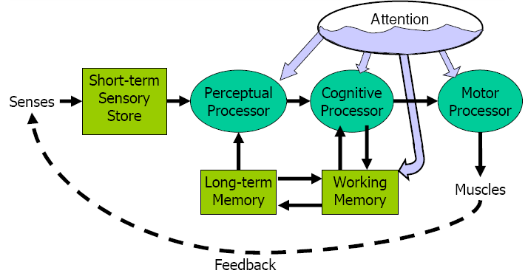
How to process information?
Human Information Processing Model

Slide 6
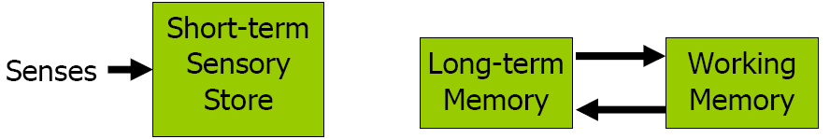
Memory properties
Encoding: type of things stored
Size: number of things stored
Decay time: how long memory lasts

Slide 7
Short-Term Sensory Store
Visual information store
Encoded as physical image
Size ~17 [7-17]bits
Decay ~200ms [70-1000 ms]
Auditory information store
Encoded as physical sound
Size ~[4.4-6.2] bits
Decay ~1500 [900-3500ms]

Slide 8
Working Memory (WM)
Small capacity: 7±2 “chunks”
Fast decay (7 [5-226] sec)
Maintenance rehearsal fends off decay
Interference causes faster decay

Slide 9
Long-term Memory (LTM)
Huge capacity
Little decay
Elaborative rehearsal moves chunks from WM to LTM by making connections with other chunks

Slide 10
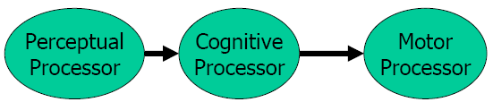
Processors
Processors have a cycle time
T_{p} ~ 100ms [50-200ms]
T_{c} ~ 70ms [30-100ms]
T_{m} ~ 70ms [25-170ms]
Fastman may be 10× faster than slowman

Slide 11
Perceptual Fusion
Two stimuli within the same PP cycle (T_{p} ~ 100ms) appear fused
Consequences
1/ T_{p} frames/sec is enough to perceive a moving picture (10 fps OK, 20 fps smooth)
Computer response < T_{p} feels instantaneous
Causality(因果关系) is strongly influenced by fusion

Slide 12
Bottom-up vs. Top-Down Perception
Bottom-up uses features of stimulus
Top-down uses context
Temporal, spatial
Draws on long-term memory

Slide 13
Chunking
“Chunk”: unit of perception or memory
Chunking depends on presentation and what you already know
T H E C A T R A N U P T H E T R E E
ETH ECA TRA NUP THE TRE
THE CAT RAN UP THE TREE
3-4digit chunking is ideal for encoding unrelated digits

Slide 14
4.2 Attention

Slide 15
Photoreceptors
Rods（视杆）
Only one kind (peak response in green wavelengths)
Sensitive to low light (“scotopic vision”)
Multiple nearby rods aggregated into a single nerve signal
Saturated at moderate light intensity (“photopic vision”)
Cones do most of the vision under photopic conditions

Slide 16
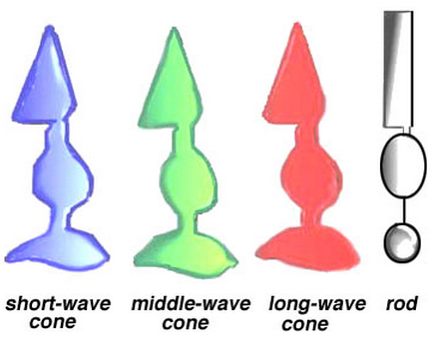
Photoreceptors
Cones（视锥）
Operate in brighter light
Three kinds: S(hort), M(edium), L(ong)
S cones are very weak, centered in blue wavelengths
M and L are more powerful, overlapping
M centered in green, L in red

Slide 17
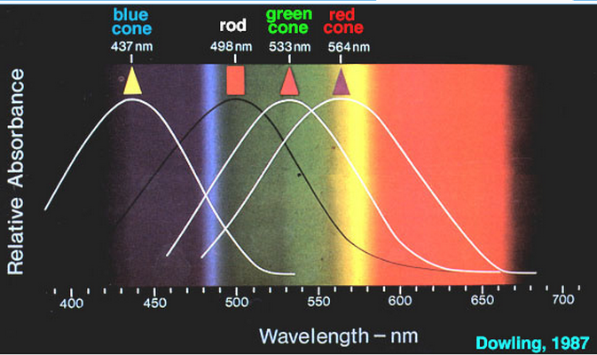
Signals from Photoreceptors
Brightness
M + L + rods
Red-green difference
L - M
Blue-yellow difference
Weighted sum of S, M, L

Slide 18
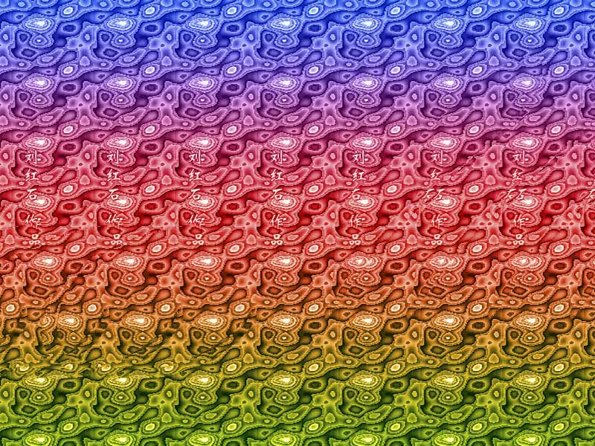

Slide 19
Color Blindness
Red-green color blindness
%8 of males
0.4% of females
Blue-yellow color blindness
Far more rare
Guideline: don’t depend solely on color distinctions
Use redundant signals: brightness, location, shape

Slide 20
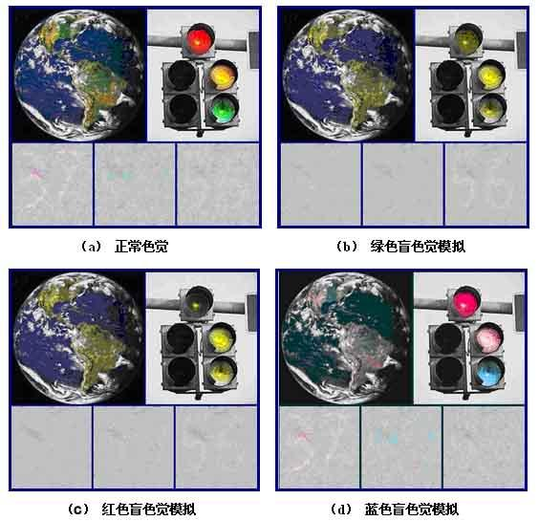

Slide 21
Chromatic Aberration（色差）
Different wavelengths focus differently
Highly separated wavelengths (red & blue) can’t be focused simultaneously
Guideline: don’t use red-on-blue text
It looks fuzzy and hurts to read
AVOID
THIS!

Slide 22
Blue Details Are Hard to Resolve
Fovea has no S cones
Can’t resolve small blue features (unless they have high contrast with background)
Lens（晶状体） and aqueous humor（水状液） turn yellow with age
Blue wavelengths are filtered out
Lens weakens with age
Blue is harder to focus
Guideline: don’t use blue against dark backgrounds where small details matter (text!)

Slide 23
Fovea Has No Rods
Rods are more sensitive to dim light
In scotopic（暗视的） conditions, peripheral vision (rod-rich) is better than foveal vision
Easier to see a dim star if you don’t look directly at it

Slide 24
2 degrees of visual angle is the area of the fovea’s high acuity, where a person can actually read text or see a detailed icon
Eye
Screen
On the rest of the screen, a person is very sensitive to movement, blinking, or other changes

Slide 28
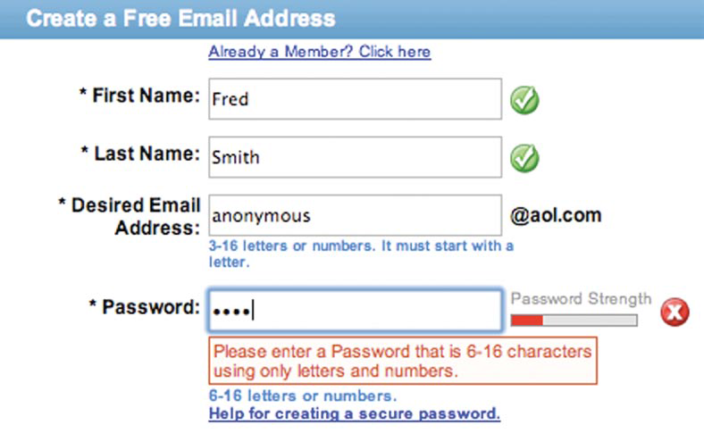

Slide 29
What is attention?
Attention is the process by which the mind chooses from among the various stimuli that strike the senses at any given moment
allows only some info to enter into consciousness

Slide 30
Spotlight metaphor
Spotlight moves serially（连续地） from one input channel to another
Visual dominance: easier to attend to visual channels than auditory channels
All stimuli within spotlighted channel are processed in parallel
Whether you want to or not

Slide 31
Say the colors of These Words Aloud
Hello
Good
OK
Map
Bug
Dog

Slide 32
Now Do It Again
红
黑
绿
蓝
橙
粉

Slide 33
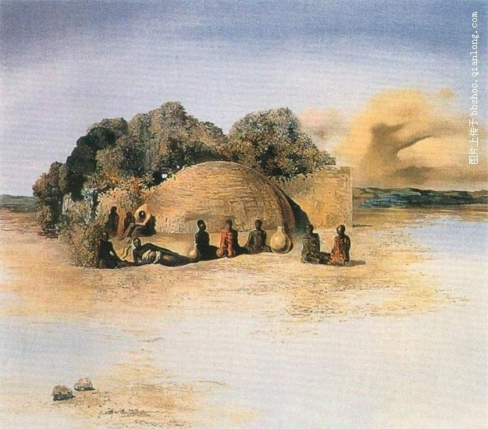

Slide 34
4.3 Cognitive Processing

Slide 35
Cognitive Processing
Cognitive processor
Compares stimuli
Selects a response
Types of decision making
Skill-based
Rule-based
Knowledge-based

Slide 36
Hick-Hyman Law of Choice Reaction Time
Reaction time depends on information content of stimulus
RT = c + d log₂ 1/Pr(stimulus)
e.g., for N equiprobable stimuli, each requiring a different response:
RT = c + d log₂ N

Slide 37
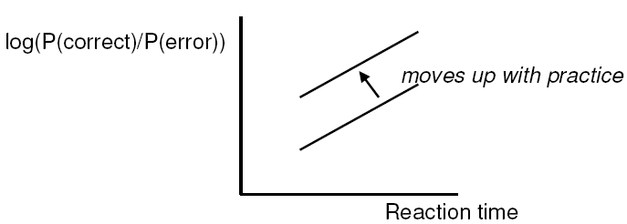
Speed-Accuracy Tradeoff
Accuracy varies with reaction time
Can choose any point on curve
Can move curve with practice

Slide 38
Divided Attention (Multitasking)
Resource metaphor
Attention is a resource that can be divided among different tasks simultaneously
Multitasking performance depends on:
Task structure
Modality: visual vs. auditory
Encoding: spatial vs. verbal
Component: perceptual/cognitive vs. motor vs. WM
Difficulty
Easy or well-practiced tasks are easier to share

Slide 39
4.4 Motor Processing

Slide 40
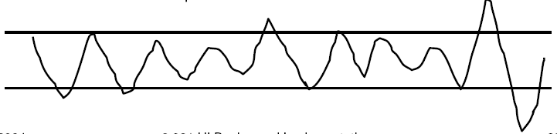
Two ways of motor processor operate
Open-loop control
Motor processor runs a program by itself
Cycle time is T_{m} ~ 70ms
Closed-loop control
Muscle movements (or their effect on the world) are perceived and compared with desired result
Cycle time is T_{p}+T_{c}+T_{m} ~240ms

Slide 41
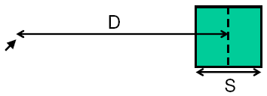
Fitts’s Law
Time T to move your hand to a target of size S at distance D away is:
T = RT + MT = a + b log(2D/S)
Depends only on index of difficulty log(2D/S)

Slide 42
Implications of Fitts’s Law
Targets at screen edge are easy to hit
Mac menubar beats Windows menubar
Unclickable margins are foolish
Hierarchical menus are hard to hit
Gimp/GTK: instantly closes menu
Windows: 0.5s timeout destroys causality
Linear popup menus vs. pie menus

Slide 43
Power Law of Practice
Time T_{n} to do a task the nth time is:
T_{n} = T₁ n^{-α}
α Is typically 0.2-0.6

Slide 44
Chapter 4 Psychology for Interaction Design
Thank you！

